Slide 1

Guidelines
Kindly use the given template for submitting your project (Make a copy of the template)
One team is only required to submit one project/ppt.
The ideal size of the presentation should not be more than 10 slides.
You are welcome to add as many POCs and design concepts to support your project.
The project should be feasible and the team members should be capable enough, to come up with the prototype of the same idea, if required.
Solutions must include at least one Google technology.

Slide 2

Team Details
  Team name:
  Team leader name:
  Problem Statement: Open Innovation

Slide 3
Brief about your solution and problem statement addressing
Lack of Career Direction
Many students choose education and jobs without understanding their interests; this system analyzes student details to suggest suitable career paths.
Stress & Mental Health Issues
Career mismatch causes stress and dissatisfaction; guidance helps students choose work they enjoy, reducing pressure.
Government & Private Job Awareness
Students lack information about job options; the platform provides guidance for both government and private sector careers.
Economic Background-Based Guidance
Low, middle, and high-income students receive career and education suggestions based on their family background.
Scholarship & Education Support
Class-wise scholarships (like NMMS) and education opportunities are suggested directly to eligible students.
Language & Accessibility Support
Text-to-voice, voice-to-text, and local language support enable rural students and uneducated parents to use the system easily.

Slide 4
Opportunities
Can guide students across different education and economic backgrounds
Creates awareness about careers, jobs, and scholarships at an early stag
Can be adopted by schools, colleges, and government career programs
  How different is it from any of the other existing ideas?
* Personalized career guidance based on student interests and background
* includes jobs, scholarships, and education guidance in one platform
* Supports local languages with text-to-voice and voice-to-text features
  How will it be able to solve the problem?
* Helps students choose careers they like and are good at
* Reduces stress by giving clear career direction
* Makes guidance accessible to all students and parents

Slide 5
List of features offered by the solution :
Personalized career recommendations based on student interests and skills
Guidance for both government and private sector job opportunityes
Class-wise and income-based career and education suggestions
Scholarship information and eligibility guidance (e.g., NMMS)
Multilingual support with local language options
Text-to-voice and voice-to-text accessibility features
Easy-to-use interface for students and uneducated parents

Slide 6
Google Technologies used in the solution

Slide 7
Process flow diagram or Use-case diagram

Slide 8
Wireframes/Mock diagrams of the proposed solution (optional)

Slide 9
Architecture diagram of the proposed solution

Slide 10
Additional Details/Future Development (if any)

Slide 11
Provide links to your:
GitHub Public Repository
Demo Video Link (3 Minutes)
MVP Link

Slide 13
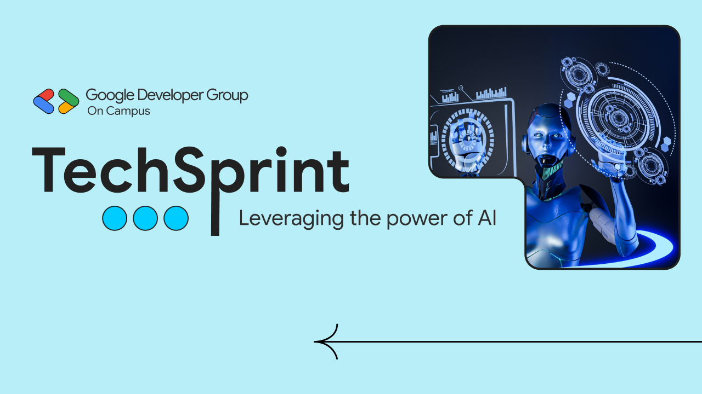
Thank you!

